Slide 1
Formal Methods in Software Engineering

Slide 2
Why Software fails?
Unrealistic project goals
Inaccurate estimates of needed resources
Badly defined system requirements
Poor reporting of the project's status
Unmanaged risks
Poor communication among customers, developers, and users
Use of immature technology
Inability to handle the project's complexity
Poor project management
Commercial pressures
Lack of Validation and verification
No execution of simulation / prototyping

Slide 3
Software failures in Formal Methods' Perspectives
Unrealistic project goals
Inaccurate estimates of needed resources
Badly defined system requirements and their specifications
Poor reporting of the project's status
Unmanaged risks
Poor communication among customers, developers, and users
Use of immature technology
Inability to handle the project's complexity
Poor project management
Commercial pressures
Lack of Validation and verification
No execution of simulation / prototyping

Slide 4
Recap of Software Development Life Cycle
Initial Study: Meeting with clients for information gathering, Prepare proposal and quotations
Analysis: Study the current system with the intention of developing new system, System analyst analyze the system with the help of visual aids such observations, inspections, interviews, etc., propose alternate solutions
Design: Best solution is selected, System designer create specification
Development: Develop solution for the given specifications, should be a running software at this stage
Testing: Test plan and test cases to find errors during executions of the system
Implementation: Installation, training, conversion of data, change over method etc.
Review: Review the software performance and provide maintenance service

Slide 5
Recap of Software Development Life Cycle (cont.…)
System requirements, Specification, Design
Proposal
Design
Coding, Unit Testing
Development
Testing
Analysis
Integration, System Testing &verification, maintenance
Implementation
Review

Slide 6
Softwares in Safety Critical Systems
Computers are often used in safety-critical systems where a failure could cause loss of life.
  Heart pacemakers
  Aircraft
  Nuclear reactor controllers
  Car engine management systems
  Radiation therapy machines

Slide 7
What is formal method?
Formal methods check the functional, non-functional requirements to see whether a system can derive qualitative and quantitative properties systematically or not?
Formal methods consist of tools & techniques, specification languages and proof theories based on formal modal to represent the overall behavior of the system

Slide 8
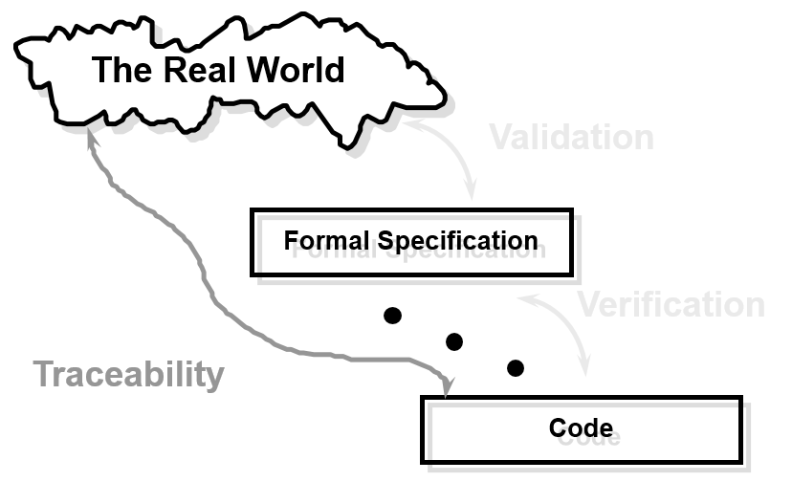
Formal Methods
  Traceability
    System-level requirements should be traceable to subsystems or components

Slide 9
Formal Methods
Formal methods can
  Be a foundation for designing safety critical systems
  Be a foundation for describing complex systems
  Provide support for program development
A way to take the specification (written in natural language) and converts it into its mathematical equivalent. It is normally used in the SDLC Analysis and Design stages. The natural language usually contains ambiguous, incomplete and inconsistent statement.

Slide 10
Formal Methods
Once a specification is translated to a mathematical form, it will remove all ambiguity and uncertainty in that statement.
Formal method will also bring to light all different probable perspective to any given variables and functions that could have been hidden behind the English language.
This can be done using a number of formal languages such as Z notation, VDM, Functional Programming, etc.

Slide 11
Why formal methods?
Very useful in safety critical systems such as emergency situations, disaster recoveries, etc.
Verify correctness properties of the system
Extremely large system can be traversed in minutes
Represent the overall behavior of the system
Efficient in terms of product development and improvements.

Slide 12
Formal Methods (recapping…)
Formal methods refer to a collection of notations and techniques for describing and analyzing systems. They can be used to improve the quality of (distributed) systems.
A formal method generally consists of a formalism
  To model a system,
  A specification language to express the desired properties of the system,
  A formal semantics to interpret both the system and the properties, and
  Verification techniques to check whether the properties are satisfied by the system.

Slide 13
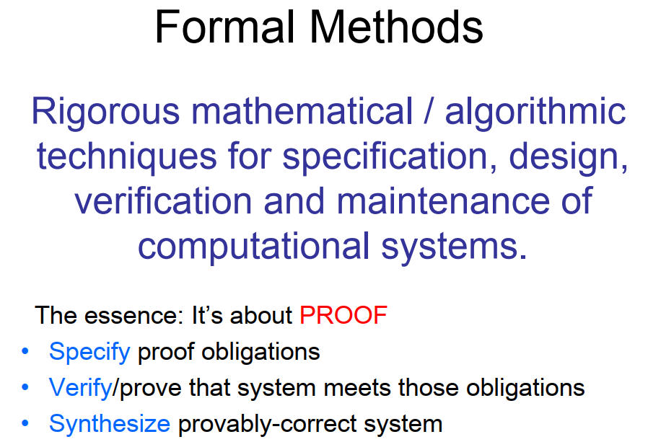

Slide 14
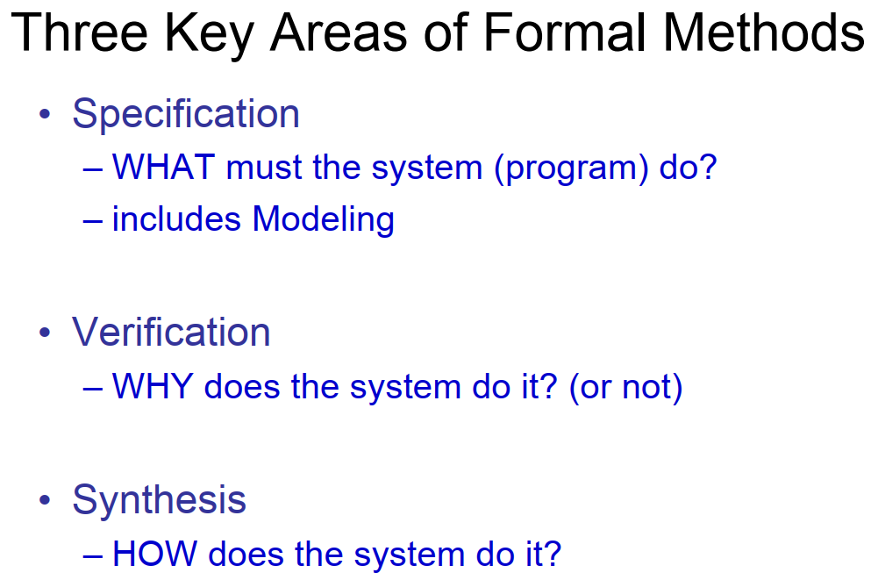

Slide 15
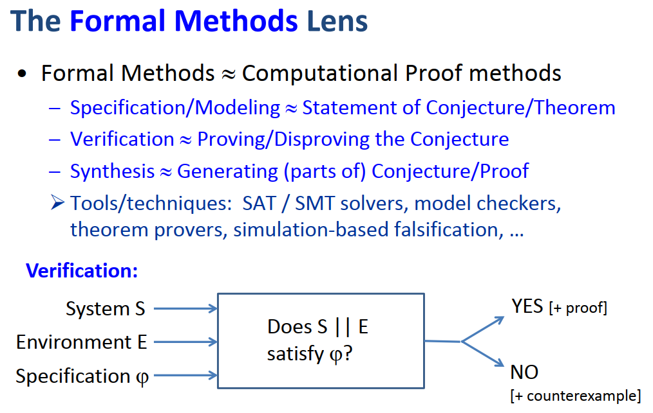

Slide 16
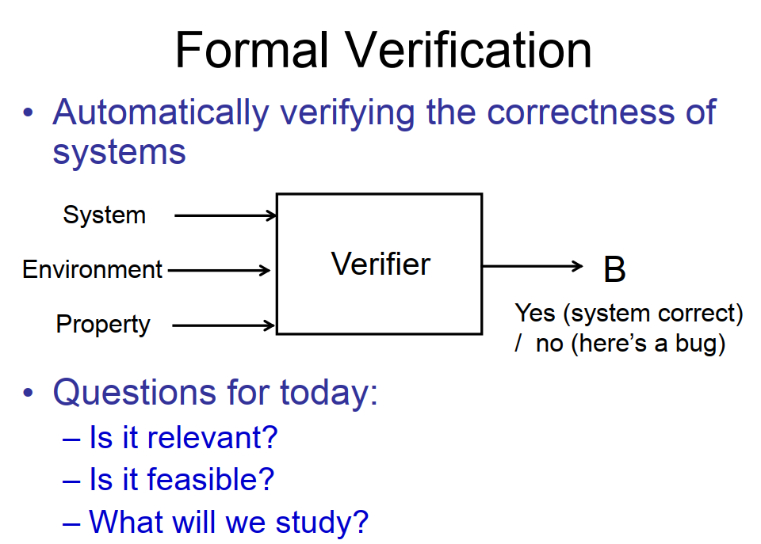

Slide 17
Formal Methods Components
Formal Methods
Model Checking
Formal Specifications
Formal Proofs
Abstraction

Slide 18
Formal Specification
The translation of non-mathematical description (diagrams, table, natural language) into a formal specification language
It represents a concise description of high-level behavior and properties of a system
Well-defined language semantics support formal deduction about the specification
Specification languages are often more expressive than computer languages
Well-defined formal specification include:
  Syntax: Rules to determine well formed sentences (formulas)
  Semantics: Rules to interpret sentences,
  Proof Theory: Rules to infer useful information

Slide 19
Good specifications for the system:
Adequate: for the problem at hand
Internally consistent: single interpretation makes true all properties
Unambiguous: only one interesting interpretation makes the specification true
Complete: The set of specified properties must be enough

Slide 20
Types of Formal Specifications
Model Oriented: Construct a model of the system behavior using mathematical objects like sets, sequences etc.
  VDM (Vienna Development Method), Z specifications
  Petri Nets, Automata theoretic models
Property Oriented: Use a set of necessary properties to describe system behavior, such as axioms, rules etc.
  Algebraic semantics
  Temporal logic models.

Slide 21
Why Formal Specification?
The development of a formal specification provides insights and in depth understanding of the software requirements and software design
  Clarify customers’ requirements
  Reveal and remove ambiguity, inconsistency and incompleteness
  Facilitate communication of requirement or design
  Provides a basis for an elegant software design

Slide 22
Model Checking
A technique relies on building a finite/infinite model of a system and checking that a desired property holds in that model
It exhaustively and automatically checks whether formal model of the system meets the given specifications or not?
It is a method to formally verify the correctness properties of finite concurrent systems.
Two generic approaches
  Temporal model checking (LTL, CTL, CTL*)
  Automatic model checking (Maude LTL model checker)
Use model checkers
  SMV (Symbolic Model Verifier)
  Maude

Slide 23
Formal Proofs
To prove an argument is valid or assumption of true hypothesis
Proof is an essential part of specification
Proofs are constructed as a series of small steps, each of which is justified using a small set of rules
Proofs can be done manually, but usually constructed with some automated assistance

Slide 24
Abstraction
Abstraction is the process of simplifying and ignoring irrelevant details.
In formal methods, abstraction is a tool for eliminating distracting detail, avoiding premature commitment to implementation choices, and focusing on the essence of the problem at hand.
Allows you to focus on the most important central properties and characteristics

Slide 25
Benefits of Formal methods
Higher level of rigor leads to better problem understanding
Defects are uncovered that would be missed using traditional specification methods
Allows earlier defect identification
Formal specification language semantics allow checks for self-consistency
Enables the use of formal proofs to establish fundamental system properties and invariants

Slide 26
Limitations to Formal Methods
Requires a sound mathematical knowledge of the developer
Different aspects of a design may be represented by different formal specification methods

Slide 27
Formal Methods in SDLC
Initial Study: Customers may approve specifications (but not usual)
Analysis: System Analysts use the specification to discover incompleteness and inconsistencies in the original requirements
Design: Designers can use it to decompose and refine a software system
Development: Programmers use the specification as a reference guide

Slide 28
Formal Methods in SDLC
Testing: Validation and debugging can take advantage of test cases and Verification needs a previous specification
Review: expected results generated by means of the specification. Specifications can be used to document the path from

Slide 29
Formal Verification
Formal verification is the process of checking whether a design satisfies some requirements (properties).
Formal verification of software programs involves proving that a program satisfies a formal specification of its behavior.

Slide 30
Recapping….
What is formal method?
Why do we need to use formal methods?
Practical Implementations of Formal methods?

